Slide 1
FINANCIAL MARKET

Slide 2
FINANCIAL MARKET
Any market place where
buyer and seller
participate in the trade of financial securities, commodities and other items of value at low transaction cost and at prices that reflect supply and demand.

Slide 3
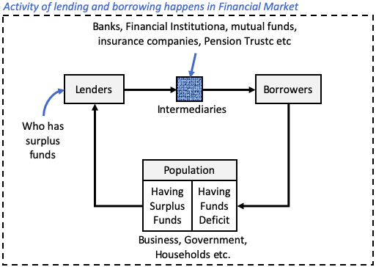
In a financial market, there is an endless activity of lending and borrowing taking place between lenders and borrowers. A typical & simplified representation of financial market is shown below:

Slide 4
Lenders: These are people who have surplus funds. They invest their money in securities available in the financial market. The lenders in a financial market can be the population of an economy (like business, government, households etc).
Borrowers: These are people who are in need of funds. They are in capital deficit. They borrow money from lenders through financial market and market intermediaries. Again, the borrowers in a financial market can be the population of an economy (like business, government, households etc).
Market Intermediaries: These are the agencies who work in an assisting role. They execute the function of fund collection from lenders, and disbursement of capital to borrowers. They also handle financial securities (stocks, bonds, etc) on behalf of the lender and borrowers. In financial market, intermediaries can be banks, brokers etc. Without intermediaries, financial market cannot run seamlessly and efficiently.

Slide 5
FUNCTIONS OF THE FINANCIAL SYSTEM
Provision of liquidity
The major function of the financial system is the provision of money and monetary assets for the production of goods and services. There should not be any shortage of money for productive ventures. In financial language, the money and monetary assets are referred to as liquidity. The term liquidity refers to cash or money and other assets which can be converted into cash readily without loss of value and time.

Slide 6
2. Mobilisation of savings
Another important activity of the financial system is to mobilise savings and channelise them into productive activities. The financial system should offer appropriate incentives to attract savings and make them available for more productive ventures. Thus, the financial system facilitates the transformation of savings into investment and consumption. The financial intermediaries have to play a dominant role in this activity.

Slide 7
3. Size transformation function
Generally, the savings of millions of small investors are in the nature of a small unit of capital which cannot find any fruitful avenue for investment unless it is transformed into a perceptible size of credit unit. Banks and other financial intermediaries perform this size transformation function by collecting deposits from a vast majority of small customers and giving them as loan of a sizeable quantity. Thus, this size transformation function is considered to be one of the very important functions of the financial system.
4. Maturity transformation function
Another function of the financial system is the maturity transformation function. The financial intermediaries accept deposits from public in different maturities according to their liquidity preference and lend them to the borrowers in different maturities according to their need and promote the economic activities of a country.

Slide 8
Classification of financial markets
Unorganised markets
In these markets, there are a number of moneylenders, indigenous bankers, traders, etc., who lend money to the public. Indigenous bankers also collect deposits from the public. There are also private finance companies, chit funds, etc., whose activities are not controlled by the RBI. Recently, the RBI has taken steps to bring private finance companies and chit funds under its strict control by issuing non-banking financial companies (Reserve Bank) Directions, 1998. The RBI has already taken some steps to bring the unorganised sector under the organised fold. They have not been successful. The regulations concerning their financial dealings are still inadequate and their financial instruments have not been standardised.
Organised markets
In the organised markets, there are standardised rules and regulations governing their financial dealings. There is also a high degree of institutionalisation and instrumentalisation. These markets are subject to strict supervision and control by the RBI or other regulatory bodies. These organised markets can be further classified into two. They are: (i) Capital market. (ii) Money market.

Slide 9
STRUCTURE OF INDIAN FINANCIAL MARKET

Slide 10
STRUCTURE OF FINANCIAL MARKET
There are mainly two ways through which companies can raise funds : Banks and financial markets.
Banks act as intermediaries by using the money saved by a group of people to give loans to another group who need it ( or they may buy securities from the capital market).
Financial market is the place where assets (securities) such as stocks, bonds, derivatives, foreign exchange, and commodities are being traded.

Slide 11


Slide 12

Financial markets are divided into two separate segments for short term financing (money market) and long term financing(capital market).

Slide 13
Money Market
Money market is a type of market which trade in such securities which has a short maturity periods (less than one year). Such securities are often risk free. As their maturity periods are smaller (more liquid), and the risk of loss (volatility) is also smaller, hence their yield is also less. Common men generally invest in money market through money market mutual funds.
The money market contributes to the economic stability and development of a country by providing short-term liquidity to governments, commercial banks, and other large organizations. Investors with excess money that they do not need can invest it in the money market and earn interest.
The important money market instruments are repos /reverse repos, call money, commercial bills, treasury bills, etc.

Slide 14
Below are the main objectives of the money market:
Providing borrowers such as individual investors, government, etc. with short-term funds at a reasonable price. Lenders will also have the advantage of liquidity as the securities in the money market are short-term.
It also enables lenders to turn their idle funds into an effective investment. In this way, both the lender and borrower are at a benefit.
RBI regulates the money market. Therefore, in turn, helps to regulate the level of liquidity in the economy.
Since most organizations are short on their working capital requirements. The money market helps such organizations to have the necessary funds to meet their working capital requirements.
It is an important source of finance for the government sector for both national and international trade. And hence, provides an opportunity for the banks to park their surplus funds.

Slide 15
Treasury bills
Treasury bills or T-bills, which are money market instruments, are short term debt instruments issued by the Government of India and are presently issued in three tenors, namely, 91 day, 182 day and 364 day.
Treasury bills pay no interest. These bills are issued in multiple of Rs. 25,000.
They are issued at a discount and redeemed at the face value at maturity. For example, a 91 day Treasury bill of Rs.100/- (face value) may be issued at say Rs. 98.20, that is, at a discount of say, Rs.1.80 and would be redeemed at the face value of Rs.100/-. The return to the investors is the difference between the maturity value or the face value (that is Rs.100) and the issue price.

Slide 16
Call money market
The call money market is a market for very short – term fund repayable on demand and with a maturity period varying between one day to a fortnight.
The money that is lent for one day in this market is known as call money and if it exceeds one day but less than 15 days it is referred to as notice market.
Notes:
Call Money Market
CMM is the market for very short-term loans most probably – one-day loans traded by banks. Borrowers and lenders in the CMM are mainly banks themselves. Banks can access CMM to meet their reserve requirements or to cover a sudden shortfall in cash on any particular day. Besides this, banks also borrow to meet the CRR and SLR requirements. Since the CMM is dominated by banks, it is otherwise called as interbank call money market. Interest rate are reached through auction and it is called call rate. Participants Main feature of the call money market is that the banks themselves are the borrowers and lenders. Participants in the call money market are banks and related entities specified by the RBI. Hence, the call money market is known as interbank call money market. Surplus banks will give loans to other banks. Deficit banks that need funds will purchase it. Scheduled commercial banks (excluding RRBs), co-operative banks (other than Land Development Banks) and Primary Dealers (PDs), are permitted to participate in call/notice money market both as borrowers and lenders. Significance of CMM: the liquidity position of the banks can be known from the Call Money rate. If banks don’t have much liquidity, most of them will be borrowers and call rate shoot up. The RBI comes to know about this and can take follow up action. The call rate is thus the operating target of RBI’s monetary policy.

Slide 17
Commercial bill
Deals in a bill of exchange, a seller draws a bill of exchange on the buyer to make payment within a certain period of time .
The bill can be domestic bill or foreign bill of exchange.

Slide 18
Commercial Bill:
When goods are sold on credit, the buyer becomes liable to make payment on a specified date in future. For this, seller draws the bill and buyer accepts it.
After buyer’s acceptance the bill becomes a marketable Instrument and is called a trade bill or bill of exchange. If, the seller needs funds before the date of maturity, these bills can be discounted with a bank. When a trade bill is discounted by a commercial bank, it is known as commercial bill. Therefore, a bill of exchange issued by a commercial organization to raise money for short term need is known as commercial bill.

Slide 19
2. Capital Market
On one hand Indian household has small savings. On other hand corporates need funds to meet their capital requirements. If an Indian household wants to invest in a business, it can be done through the security market. How? By buying stocks, bonds from the capital market (stock market). Capital market has further two branches.
The capital market aids raising of capital on a long-term basis, generally over 1 year.
It consists of a primary and a secondary market and can be divided into two main subgroups – Bond market and Stock market.

Slide 20
Based on market levels
● Primary market:
a. Primary market is a market for new issues or new financial claims. Hence it’s also called new issue market.
b. The primary market deals with those securities which are issued to the public for the first time.
c. Therefore, primary market is the market where the newly started company issued shares to the public for the first time through IPO (initial public offering).
● Secondary market:
It’s a market for secondary sale of securities.
In other words, securities which have already passed through the new issue market are traded in this market.
Generally, such securities are quoted in the stock exchange and it provides a continuous and regular market for buying and selling of securities.
Simply put, Secondary market is the market where the second hand securities are sold.

Slide 21
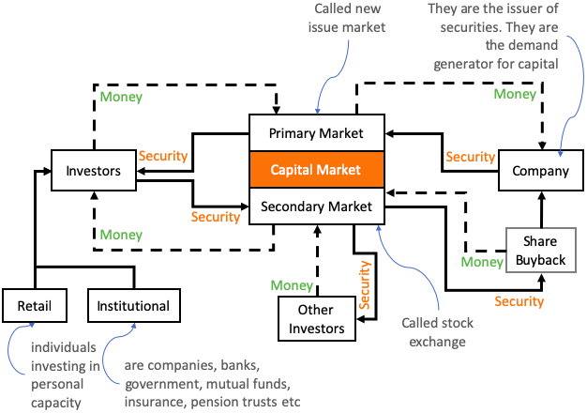

Slide 22
(a) Primary Market: This market is also called the new issue market. Company raise capital here to fund its business activity. In the primary market, companies issue their securities for the first time to public (in form of shares or bonds). It is here where the IPO’s are issued by companies.
(b) Secondary Market: Households who’ve bought the security in primary market can sell (exit) it in secondary market. When we say ‘stock exchange’ we are actually referring to the secondary market. Here the already issued securities are traded between buyers and sellers independent of the issuers intervention. If the issuer (company) wants to buyback its shares, they have to do it in secondary market.

Slide 23
Share market works in the following order:
1. A company gets listed in the primary market through an IPO.
2. Shares get distributed in the Secondary Market
3. The stocks issued can be traded by the investors in the secondary market.
4. Stock brokers and brokerage firms are entities registered with the stock exchange which offers you to buy particular share at said price
5. Your broker passes on your buy order to the exchange, which searches for a sell order for the same share.
6. The process takes T+2 days i.e. you will get your shares deposited in your demat account in two working days.

Slide 24













Slide 25
Equity market
It is a marketplace in which shares are issued and traded, either through exchanges.
It is also known as stock market, it is one of the most vital areas of a market economy.

Slide 26
Debt market
Debt market, also known as bond market. In this market, bonds are issued and traded. Bonds are securities that represent debt owned by the issuer to the investor.

Slide 27
Secondary market
Primary market
The place where fresh issue of shares is
made is known as primary market
Only ones securities can be sold
Intermediary is underwriters
Price is fixed
The place where formerly issued securities
are traded is known as secondary market
Multiple times securities can be sold
brokers
Price fluctuates, depends on the demand and supply force
investors to Investor
5.Securities - bought & sold between
company & investors

Slide 28
Distinction Between Primary & Secondary market
The main points of distinction between the primary market and secondary market are as follows:
Function: While the main function of primary market is to raise long-term funds through fresh issue of securities, the main function of secondary market is to provide continuous and ready market for the existing long-term securities.
Participants: While the major players in the primary market are financial institutions, mutual funds, underwriters and individual investors, the major players in secondary market are all of these and the stockbrokers who are members of the stock exchange.
Listing Requirement: While only those securities can be dealt within the secondary market, which have been approved for the purpose (listed), there is no such requirement in case of primary market.
Determination of prices: In case of primary market, the prices are determined by the management with due compliance with SEBI requirement for new issue of securities. But in case of secondary market, the price of the securities is determined by forces of demand and supply of the market and keeps on fluctuating.

Slide 29

Money market
Capital market
1. The primary instruments utilized as a part of the capital market are
debentures, shares, bonds.
The primary credit instruments of the money market are bills of exchange, call money
The capital market compact in borrowing and lending of long term
funding which means the time period is more than one year.
capital market instruments carry high risk
capital market are not that much liquid.
The money market make an agreement for borrowing and lending of short term funds which shows time period is one year or less than one year.
The instruments traded in money market carry low risk
The money market instruments are rich in liquidity.

Slide 30
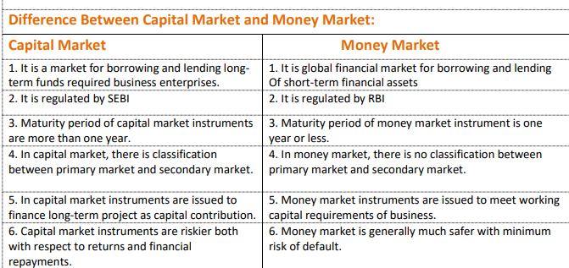

Slide 31
Read up on:
Role of stock exchanges and stock indices

Slide 32


